Slide 1
Web Programming
Lecture 5
JavaScript
Mahhek Tahir
Notes:
.

Slide 2
What is javascript?
A lightweight, interpreted programming language.
Used for creating dynamic and interactive web content.
Runs in the browser (client-side) and on servers (Node.js).
Example Uses:
Form validations.
Animations.
Updating DOM dynamically.

Slide 3
Why javascript?
One of the most popular languages in the world.
Essential for web development (HTML + CSS + JS).
Versatile: Can be used for frontend, backend, game development, and more.
Tons of libraries and frameworks (React, Angular, etc.).

Slide 4
Inline JavaScript
<a href="#" onClick="alert('Hey I am Inline JavaScript');">click here</a>

Slide 5
Embedded JavaScript
<html>
<head>
<script>
alert(“Embedded JavaScript");
</script>
</head>
The simple HTML puts a reference to external JavaScript file inside the script tag
Adding src attribute to the script tag causes browsers to look for that file.

Slide 6
Using External Scripts
<html>
<head>
<script src=“script.js”></script>
</head>
The simple HTML puts a reference to external JavaScript file inside the script tag
Adding src attribute to the script tag causes browsers to look for that file.

Slide 7
JavaScript’s Reputation
• Everything is type sensitive, including function, class, and variable names.
• The scope of variables in blocks is not supported. This means variables declared inside a loop may be accessible outside of the loop, counter to what one would expect.
• There is a === operator, which tests not only for equality but type equivalence.
• Null and undefined are two distinctly different states for a variable.
• Semicolons are not required, but are permitted (and encouraged).
• There is no integer type, only number, which means floating-point rounding errors are prevalent even with values intended to be integers.

Slide 8
Javascript Basic Syntax
Variables: name = "John";
let name = "John";
const pi = 3.14;
var age = 25;
Data Types: String, Number, Boolean, Object, Array, Undefined, null
Operators: +, -, *, /, %, ++, - - , ==, ===, !=, !==, >, <, >=, <=, &&, ||.
Example Code: let sum = 5 + 3;
console.log("Sum is", sum); // Output: Sum is 8

Slide 9
Data Types
// Numbers:
let length = 16;
let weight = 7.5;
// Strings:
let color = "Yellow";
let lastName = "Johnson";
// Booleans
let x = true;
let y = false;
// Object:
const person = {firstName:"John", lastName:"Doe"};
// Array object:
const cars = ["Saab", "Volvo", "BMW"];
// Date object: const date = new Date("2022-03-25");

Slide 10
Difference: var, let and const
var and let create variables that can be reassigned another value.
const creates "constant" variables that cannot be reassigned another value.
developers shouldn't use var anymore. They should use let or const instead.
if you're not going to change the value of a variable, it is good practice to use const.

Slide 11
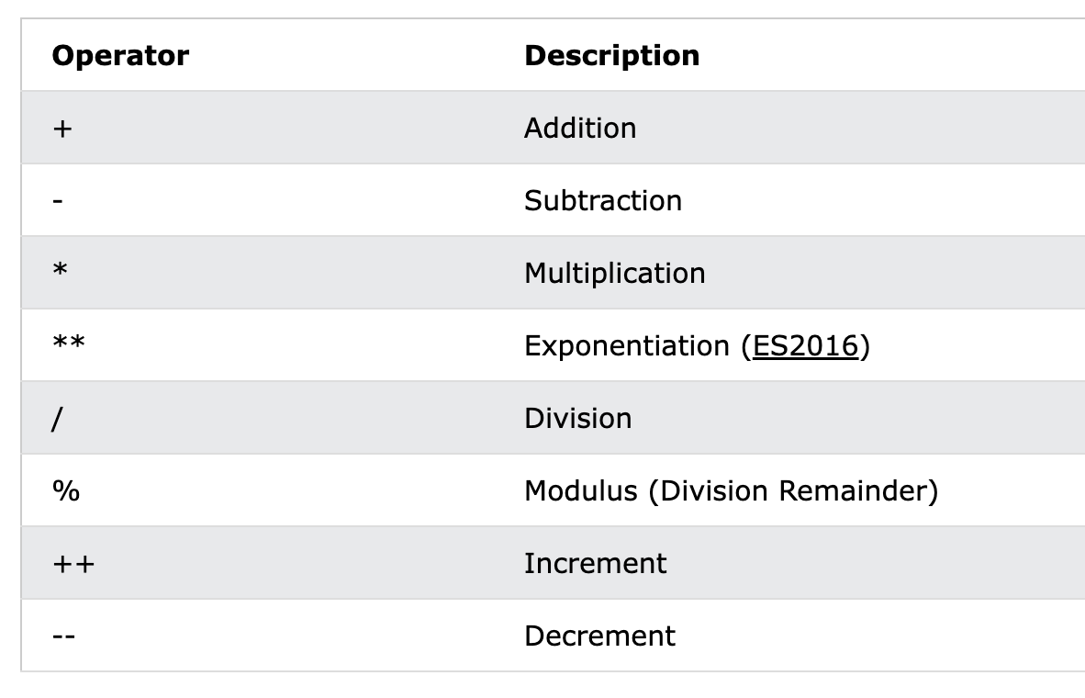
Arithmetic operators
JavaScript performs implicit type coercion
String Coercion (Number → String)
When a number is added to a string, JavaScript converts the number into a string and performs concatenation. console.log(2 + "2"); // "22"
Number Coercion (String → Number)
When a string contains a number and is used with mathematical operators (-, *, /), JavaScript converts it into a number. console.log("10" - 5); // 5

Slide 12
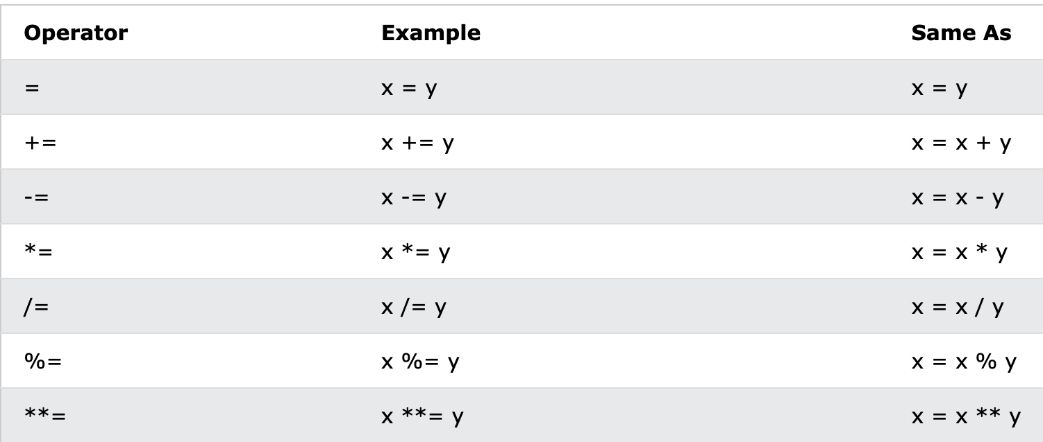
JS Assignment operators

Slide 13
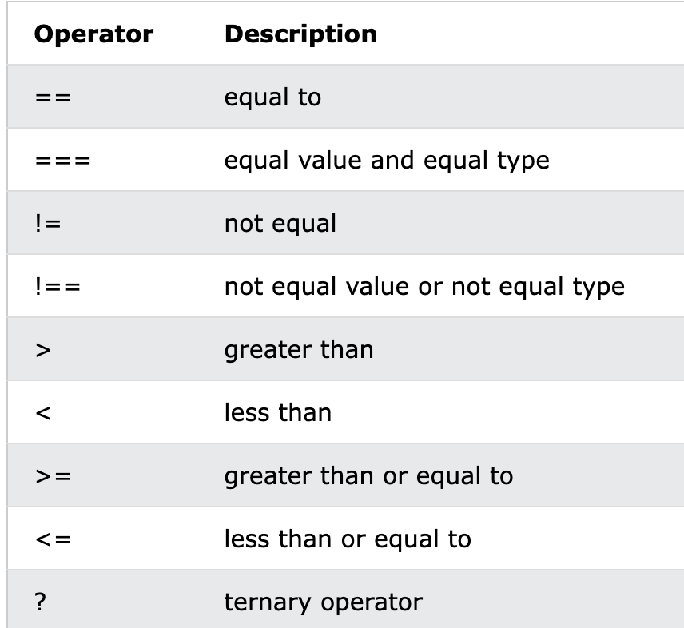
JS Comparison Operators

Slide 14
JS Objects
// Create an Object
const person = {
firstName: "John",
lastName: "Doe",
age: 50,
eyeColor: "blue"
};
let firstName = person.firstName
let age = person[“age”]
Add new property: person.nationality = "English";
Delete a property: delete person.age;

Slide 15
JS Nested Objects
myObj = {
name:"John",
age:30,
myCars: {
car1:"Ford",
car2:"BMW"
}
}
myObj.myCars.car2;
myObj.myCars["car2"];
myObj["myCars"]["car2"];

Slide 16
String methods
length
charAt()
toUpperCase()
toLowerCase()
at()
[ ]
slice()
substring()
substr()
explore using links
concat()
trim()
trimStart()
trimEnd()
padStart()
padEnd()
repeat()
replace()
replaceAll()
split()

Slide 17
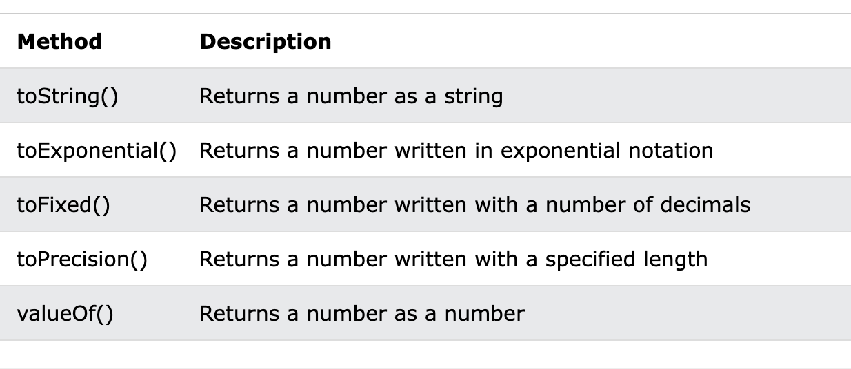
Number methods

Slide 18
Array Methods
sort()
reverse()
map()
const numbers1 = [45, 4, 9, 16, 25];
const numbers2 = numbers1.map(myFunction);
function myFunction(value, index, array) {
return value * 2;
}
length
toString()
at()
join()
pop()
push()
shift()
unshift()
delete()
concat()
explore these using links and more

Slide 19
JS Dates
const d = new Date();
const d = new Date("2022-03-25");
new Date(year,month,day,hours,minutes,seconds,ms)
Math.random();

Slide 20
Restructuring
The destructuring assignment syntax unpack object properties into variables:
const person = {
firstName: "John",
lastName: "Doe",
age: 50
};
// Destructuring
let {firstName, lastName, country = "US"} = person;

Slide 21
Resources to Learn
Slide 15: Resources to Learn More
Websites:
MDN Web Docs.
JavaScript.info.
Platforms:
FreeCodeCamp, Codecademy, or W3Schools.

